Slide 1
Analyzing Azure Cosmos DB Data
With Azure Synapse Link (& others)

Slide 2








contact
Koen Verbeeck
@Ko_Ver
@koen@dataplatform.social
SQLkover.com

Slide 3
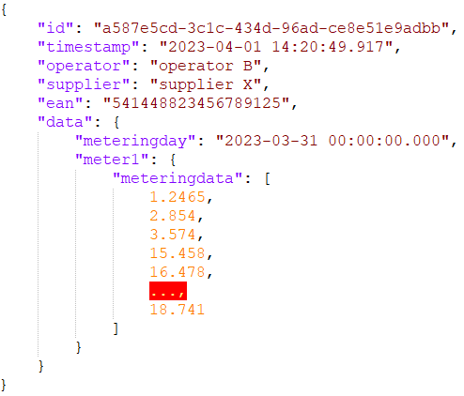



the use case
operator A
operator B
operator C
how are we going to query this data?

Slide 4

what are we going to talk about
Azure Cosmos DB recap
the Analytical Store
Azure Synapse Link
alternatives

Slide 5
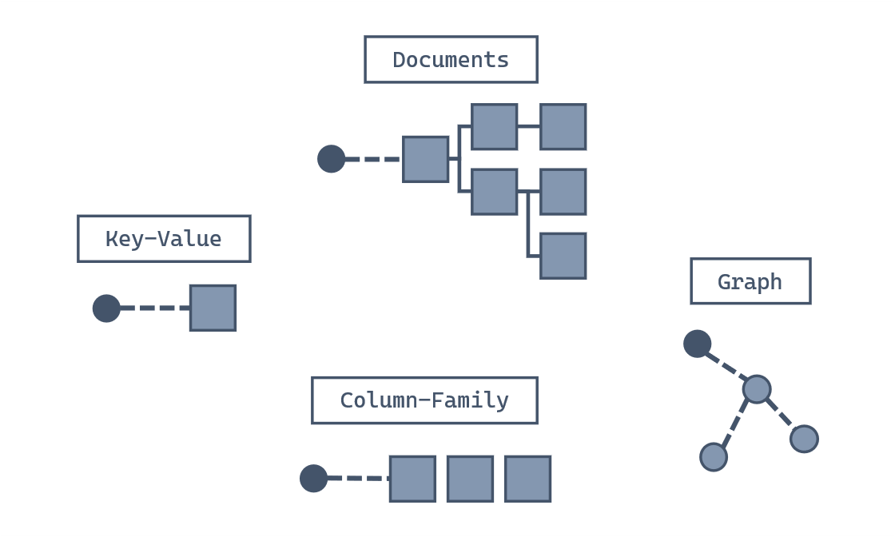
Azure Cosmos DB
SQL API
https://learn.microsoft.com/en-us/training/modules/introduction-to-azure-cosmos-db-sql-api/2-what-azure-cosmos-db-sql-api

Slide 6
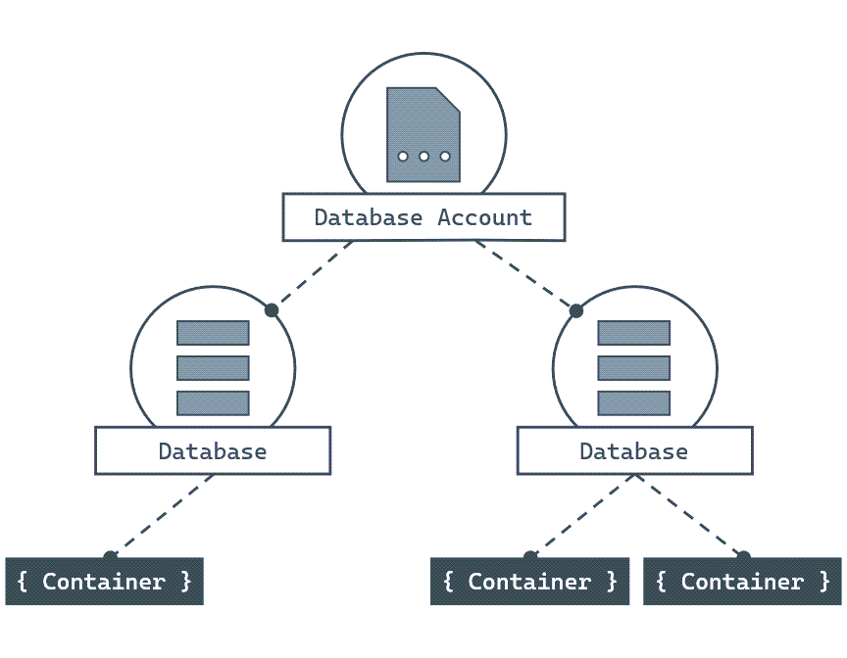
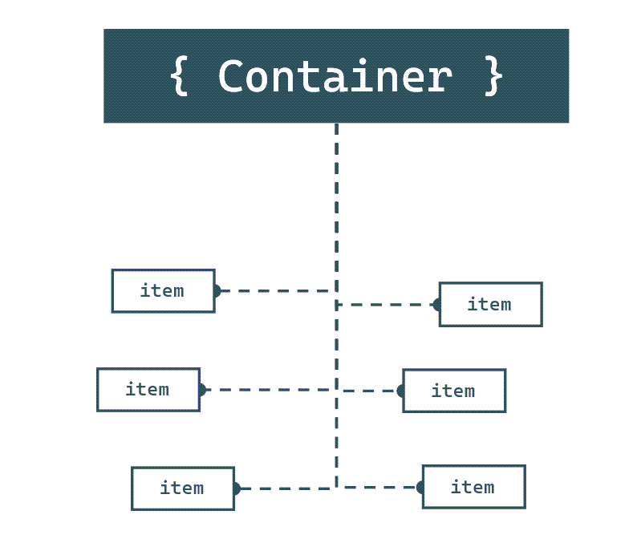
SQL API - structure
https://learn.microsoft.com/en-us/training/modules/introduction-to-azure-cosmos-db-sql-api/3-how-does-work

Slide 7
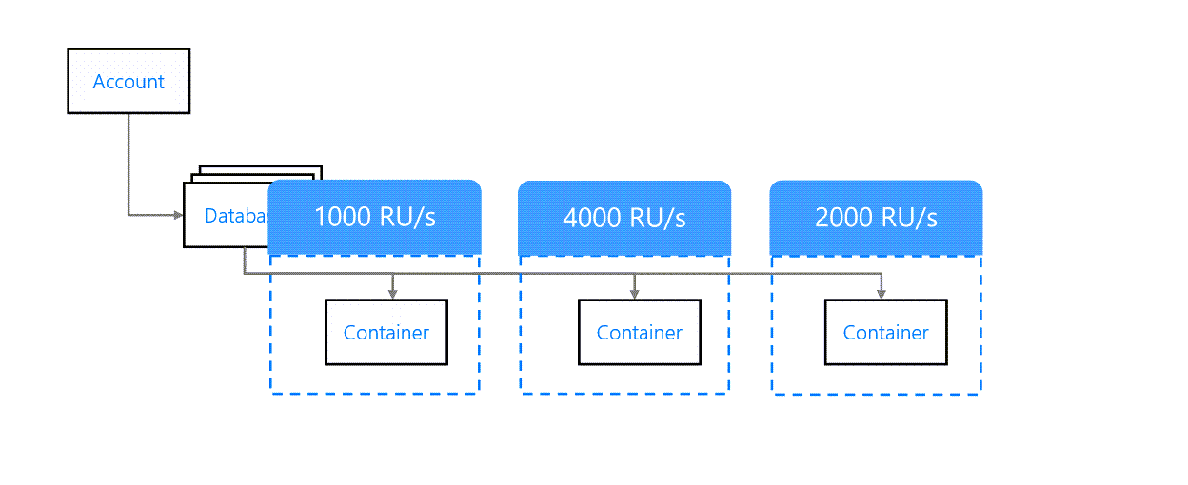
throughput
https://learn.microsoft.com/en-us/training/modules/plan-resource-requirements/2-understand-throughput

Slide 8
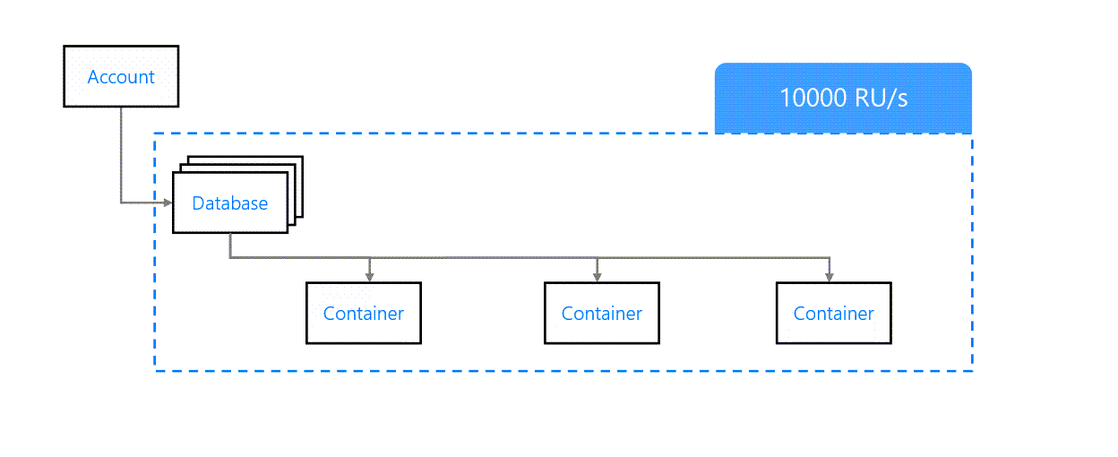
throughput
https://learn.microsoft.com/en-us/training/modules/plan-resource-requirements/2-understand-throughput

Slide 9
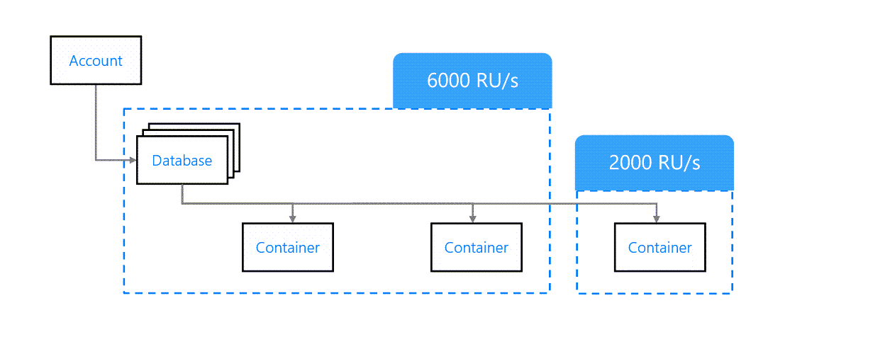
throughput
https://learn.microsoft.com/en-us/training/modules/plan-resource-requirements/2-understand-throughput

Slide 10
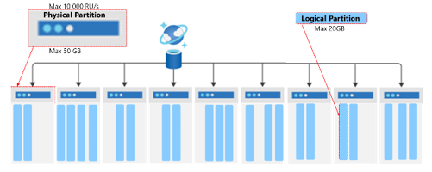
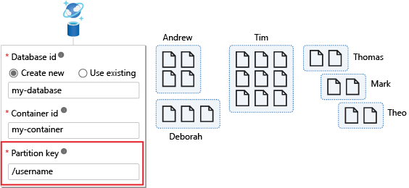
partition key
https://learn.microsoft.com/en-us/training/modules/implement-non-relational-data-model/6-choose-partition-key

Slide 11
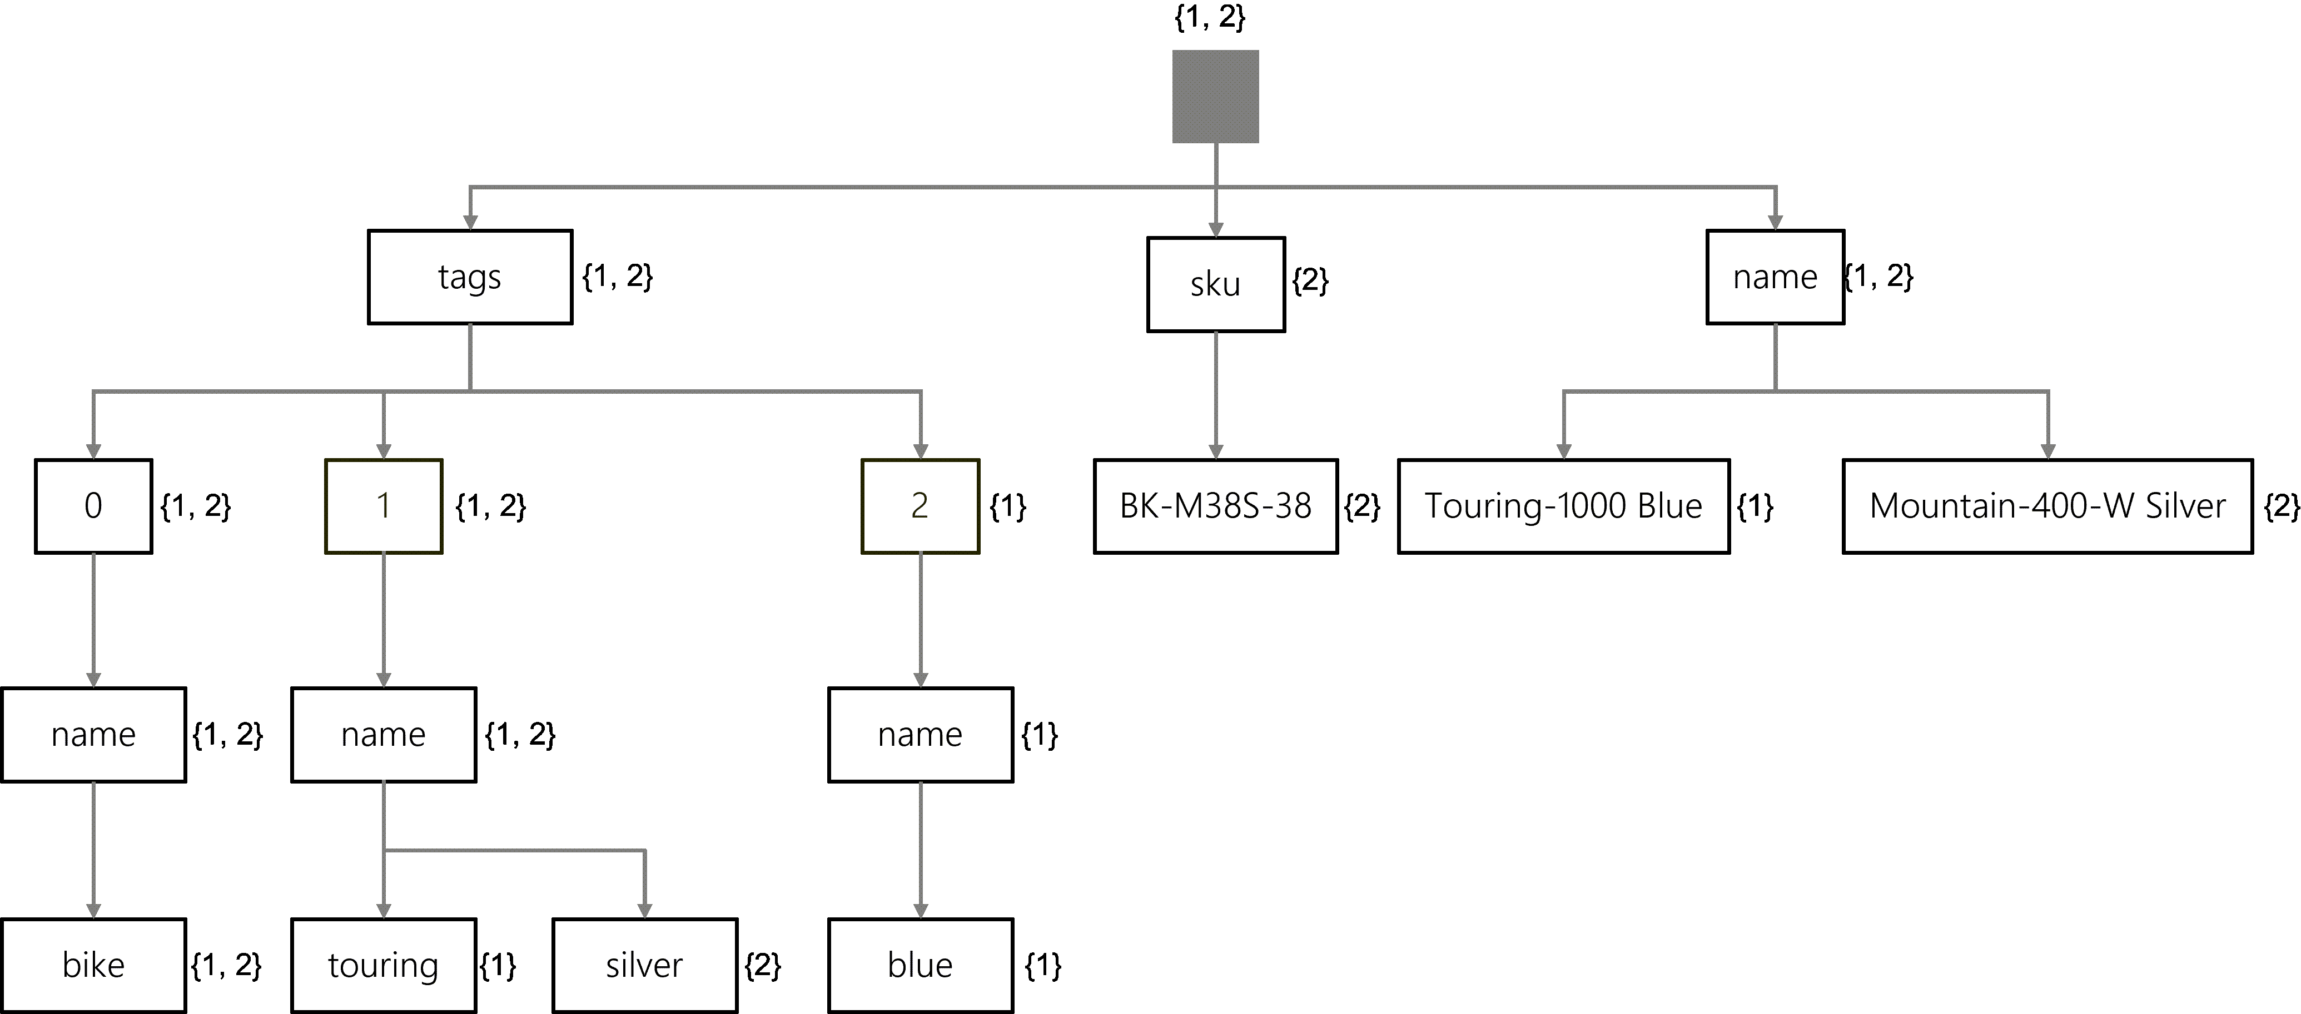
indexing
https://learn.microsoft.com/en-us/training/modules/define-indexes-azure-cosmos-db-sql-api/2-understand-indexes

Slide 12
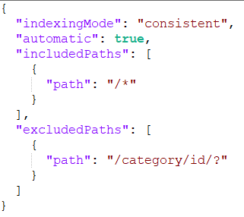
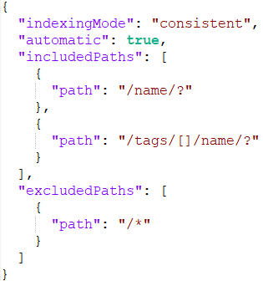
indexing policy

Slide 13

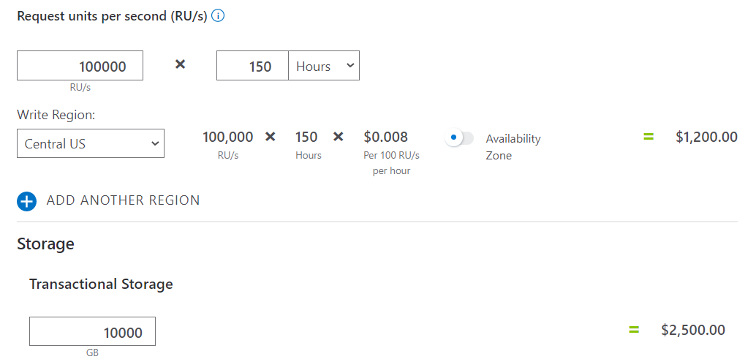
pricing

Slide 14

the use case
operator A
operator B
operator C
how are we going to query this data?

Slide 15
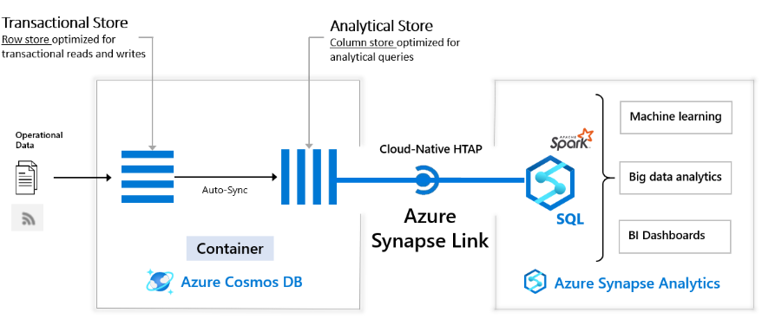
analytical store
Source: What is Azure Synapse Link for Azure Cosmos DB?

Slide 16
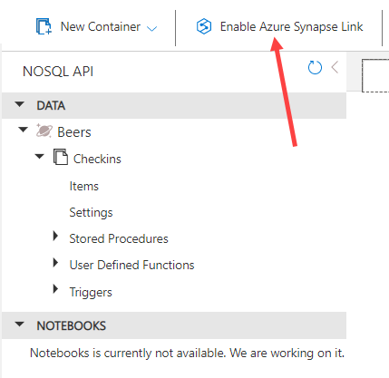
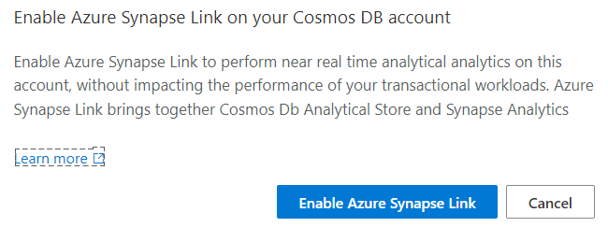
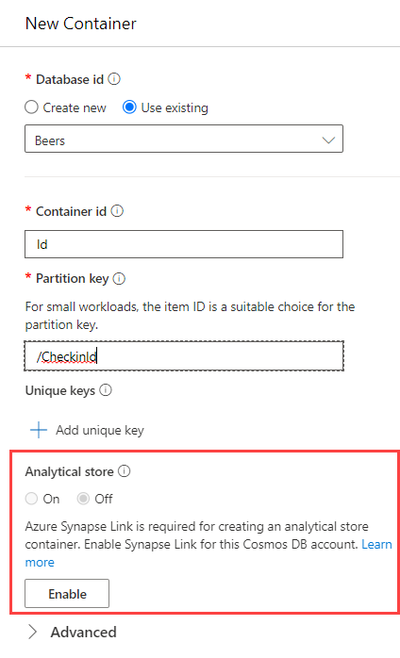
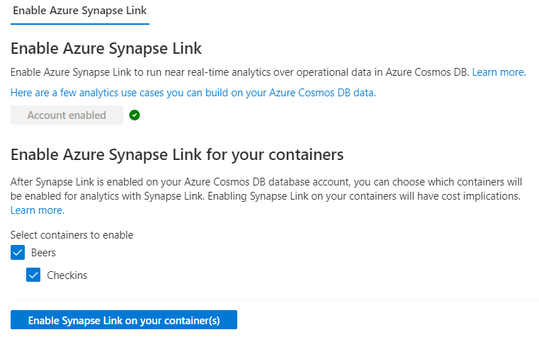
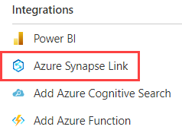
enable analytical store

Slide 17
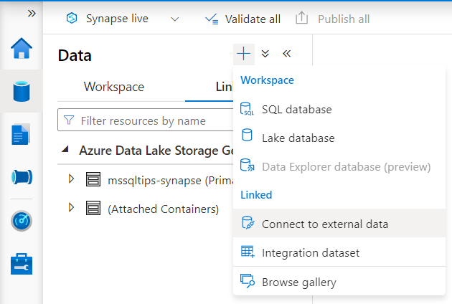
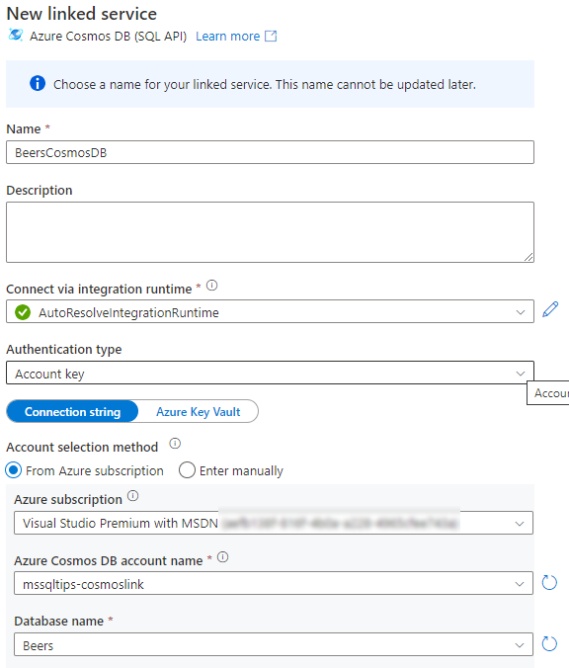
connect to external data

Slide 18
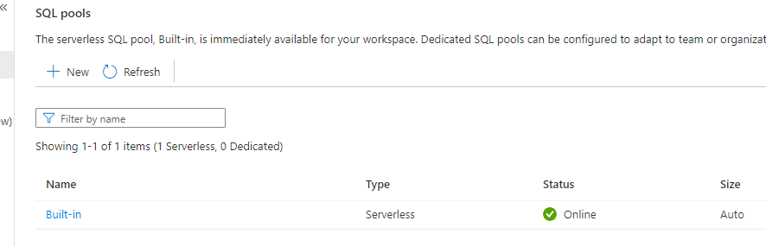
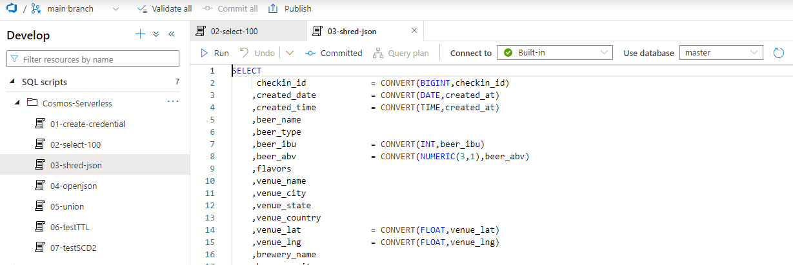
serverless SQL pools

Slide 19

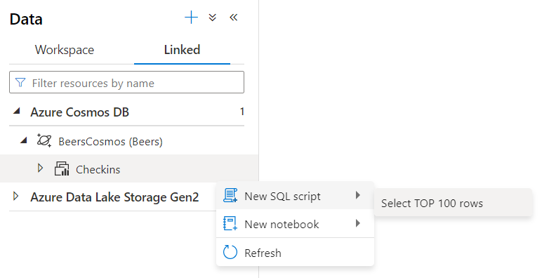
create credential
CREATE CREDENTIAL [myCosmosServerCredential]
WITH IDENTITY = 'SHARED ACCESS SIGNATURE', SECRET = 'mysecretkey'

Slide 20

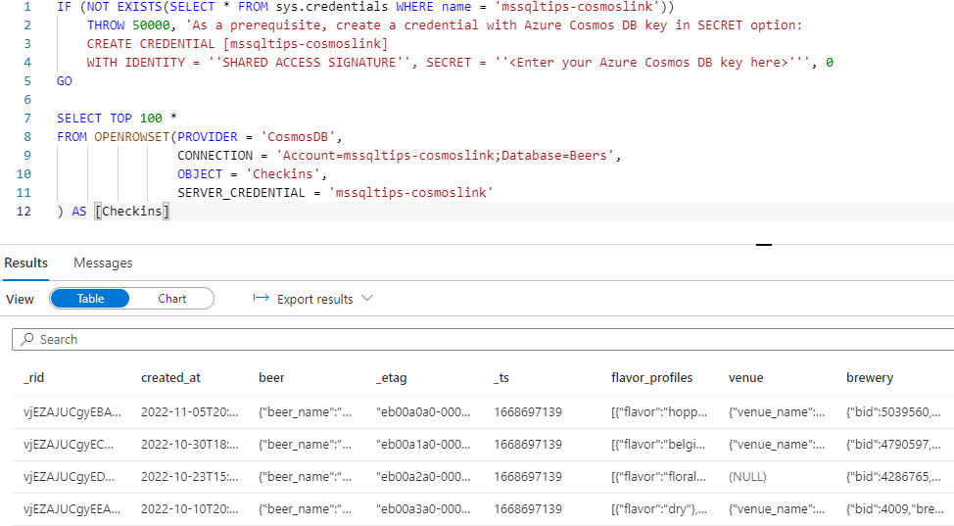
profit!

Slide 21
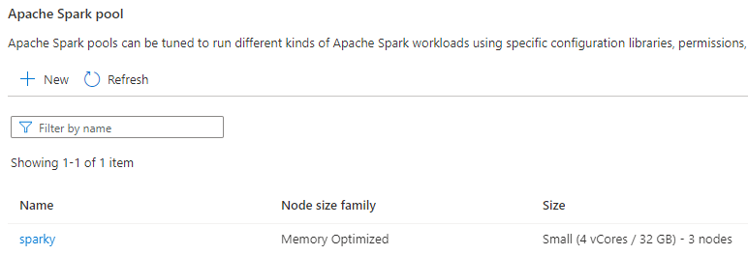
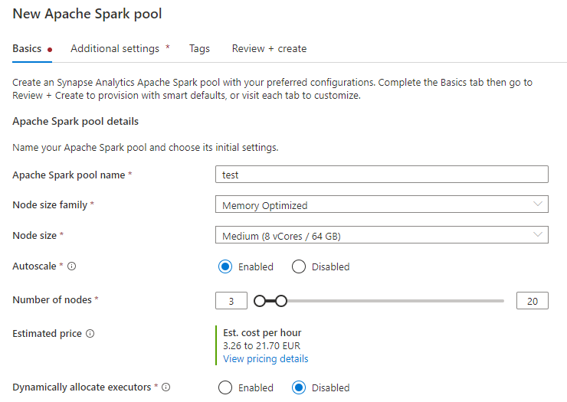
Spark pools

Slide 22
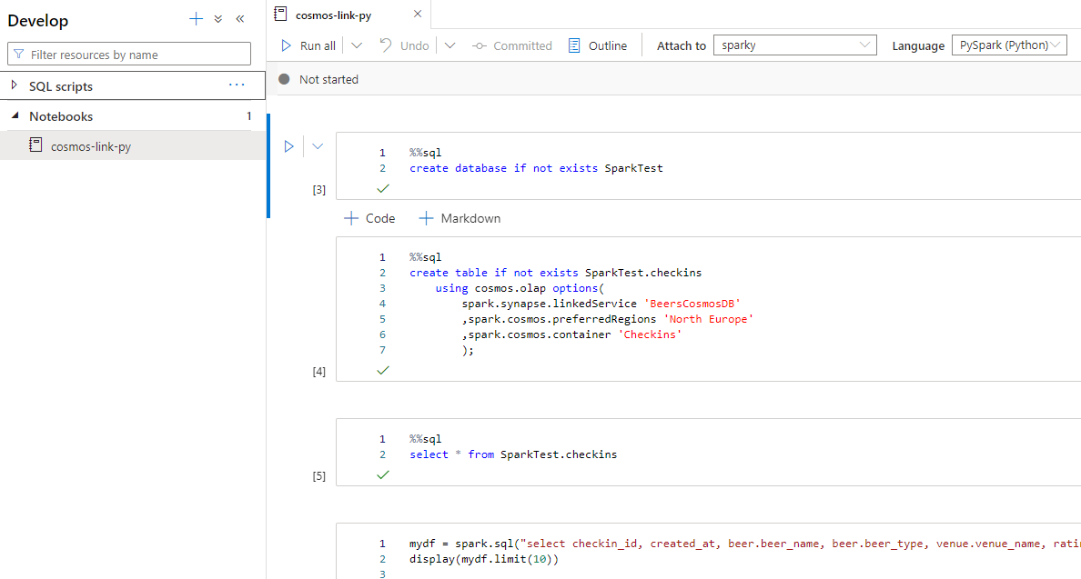
notebooks

Slide 23
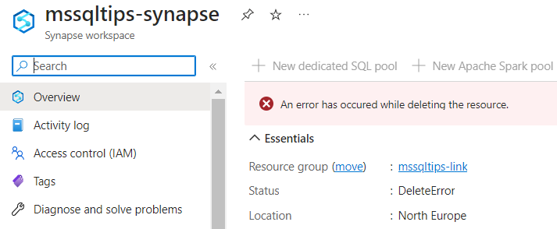
whatever you do…

Slide 24
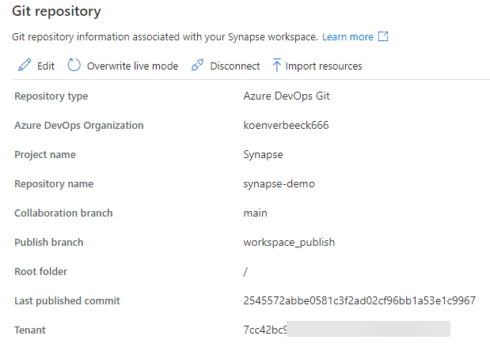
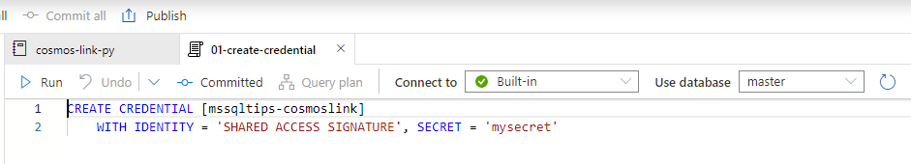
… make sure it’s in git

Slide 25
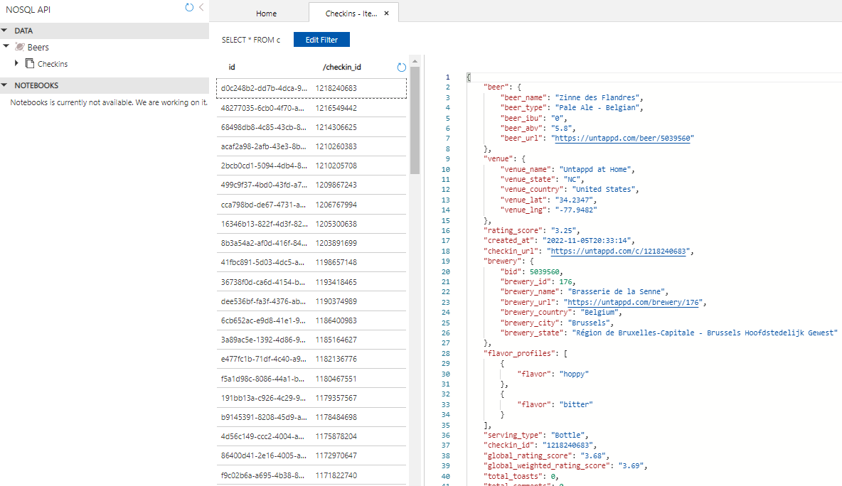

demo data

Slide 26

DEMO

Slide 27

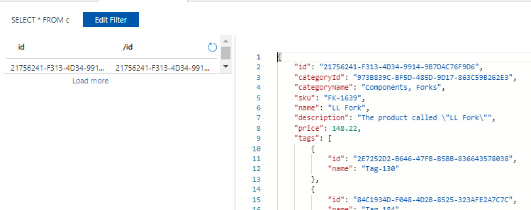

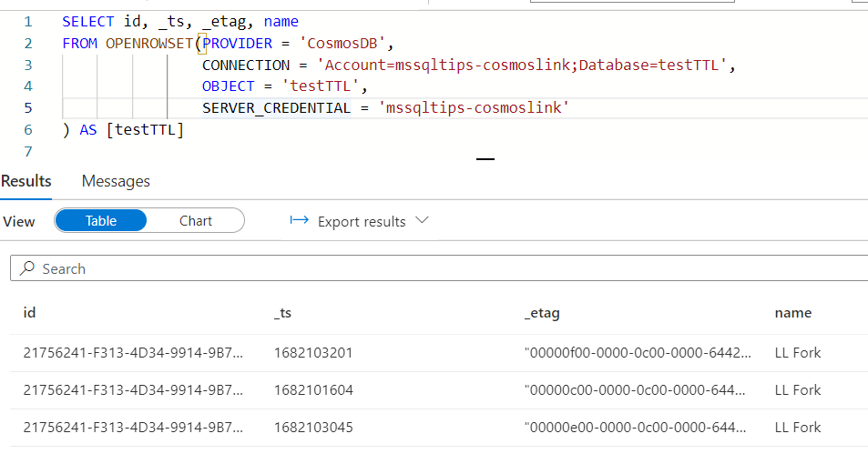

strange behavior?

Slide 28
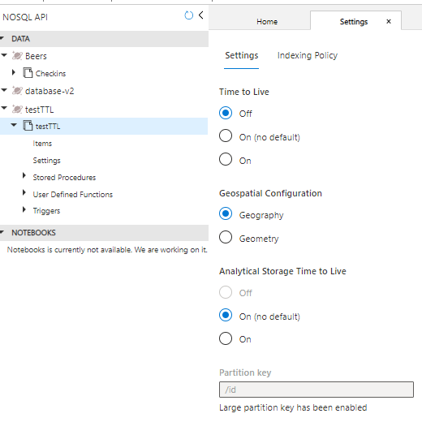
TTL vs ATTL

Slide 29
conclusion
Azure Synapse Serverless SQL Pools is NOT AN ETL TOOL
You cannot overwrite an “external table”
Deleting the table first doesn’t work
There are specific performance optimizations when working with Synapse Link for Azure Cosmos DB
Set database in a UTF-8 collation
Explicitly set schema
Filter data in WHERE clause
Best practices for integrating serverless SQL pool with Cosmos DB Analytical store via Synapse Link
Optimize database schema in serverless SQL pools using QPI library

Slide 30
alternatives
dump the data somewhere else
either by the original process
but what about updates/deletes?
read the data with the ETL/ELT tool of your choice, and store it in a data lake/lakehouse/data warehouse/whatever
ADF can have some trouble with complex JSON

Slide 31
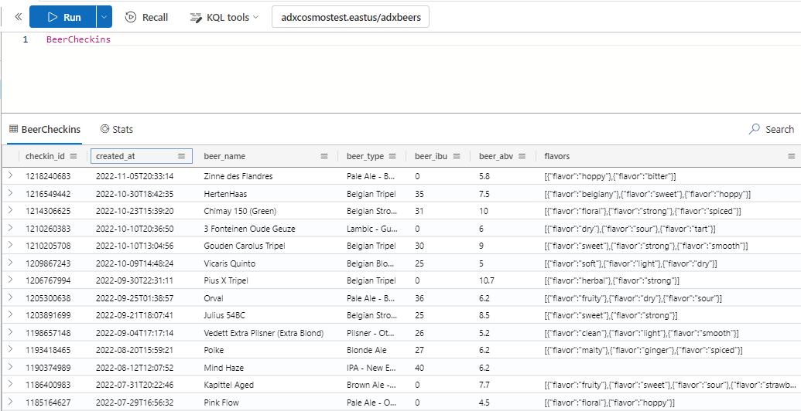
alternatives
Azure Synapse Link for Cosmos DB to Azure Data Explorer (preview)

Slide 32
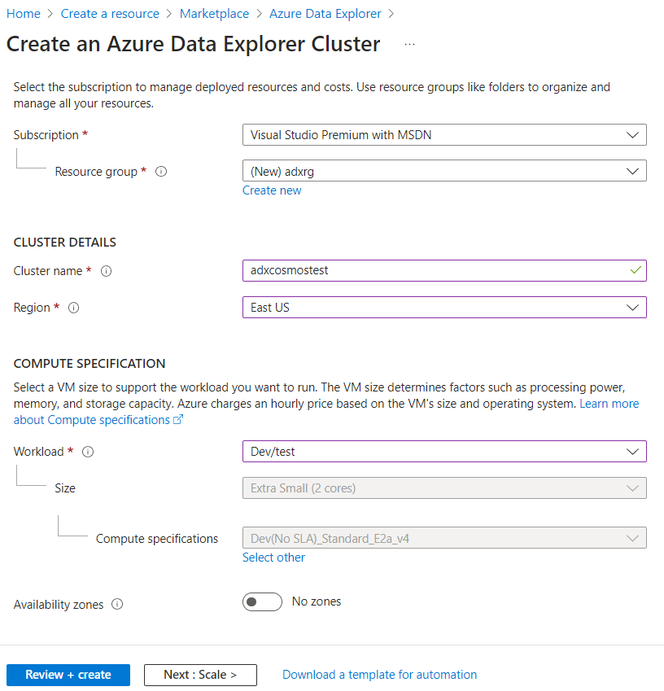
ADX
there’s also ADX pools in Azure Synapse (preview)
this scenario isn’t supported yet

Slide 33
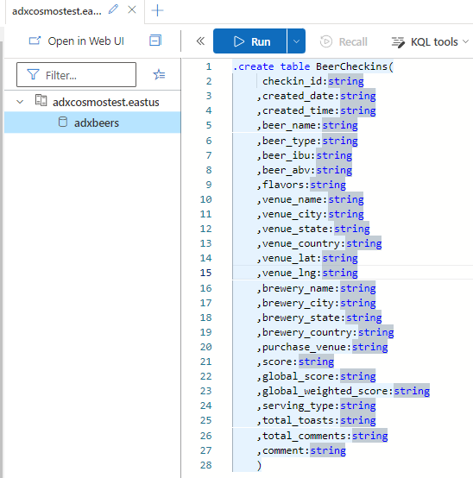
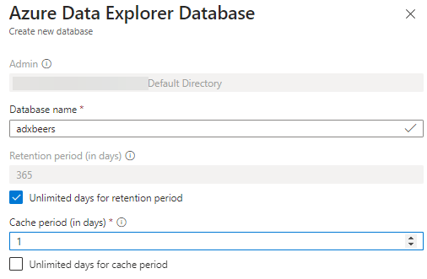
ADX

Slide 34
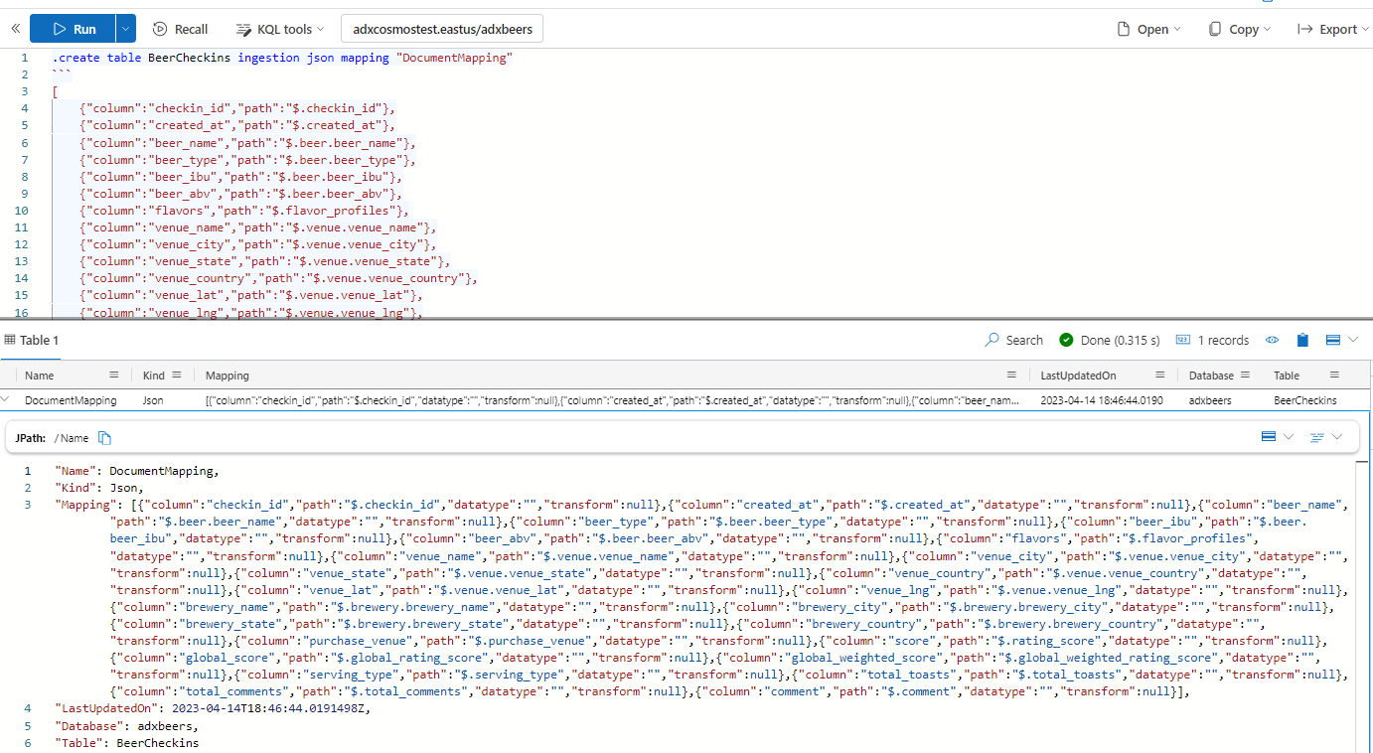
ADX

Slide 35
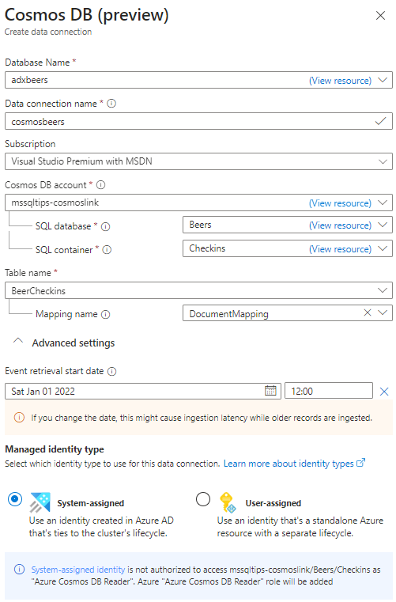
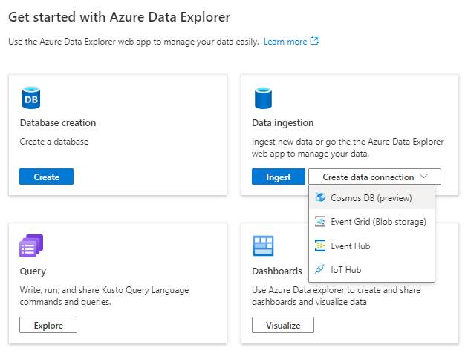
ADX

Slide 36
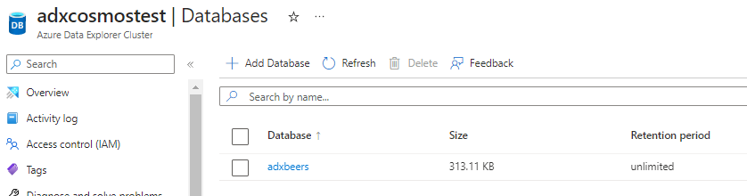

ADX
data will be imported from the specified start date
when it’s imported, you can query it with KQL

Slide 37

DEMO

Slide 38
Serverless vs ADX
Serverless
no size config
$$$ = #TB scanned
SQL
data “stays” in source (analytical store)
ad-hoc analysis pass-through for other tools
Data Explorer
cluster size is specified
$$$ = #min cluster is running + storage
KQL
data is copied to ADX - append-only (using Cosmos change feed)
ad-hoc analysis (can be used as pass-through as well)

Slide 39
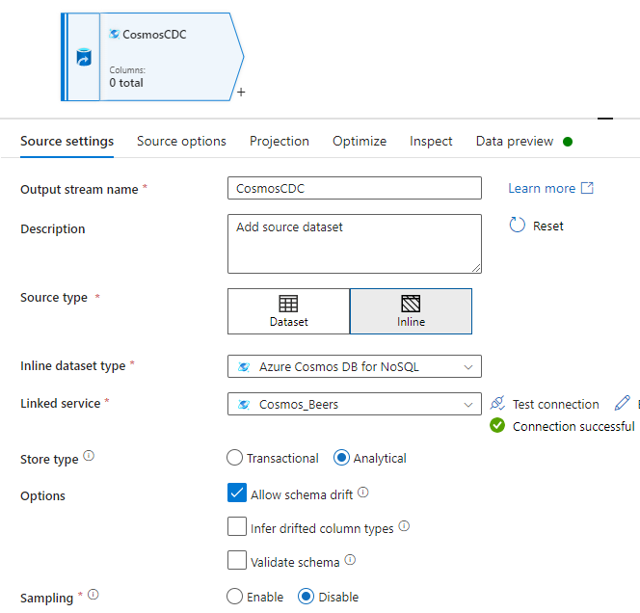
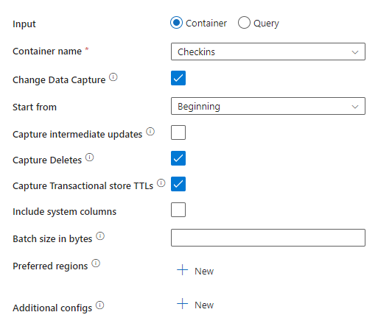
alternatives
data flow in ADF (supports CDC)

Slide 40
Serverless vs ADF
Serverless
no size config
$$$ = #TB scanned
SQL
data “stays” in source (analytical store)
ADF data flow
cluster size is specified
$$$ = #min cluster is running
no code (but you can write SQL)
data is copied from analytical store
you need a sink (not a query engine)

Slide 41

conclusion
there are multiple options to read/analyze data from Cosmos DB
either use the analytical store or copy data
cheapest option is probably serverless
but test for your use case

Slide 42
resources
Cosmos DB Learning Path
How to Install Cosmicworks Sample Database in Azure Cosmos DB
What is Azure Cosmos DB analytical store?
Analyze Azure Cosmos DB data with Synapse Serverless SQL Pools
Azure Cosmos DB to Azure Data Explorer Synapse Link – YouTube
Cosmos Down Under – Podcast
Capture Changed Data From your Cosmos DB analytical store (ADF)

Slide 43

And please give feedback!

